Slide 1

Emerald Green Power
15/07/24

Slide 2


Main Questions
Identifying the heating input and subsequent electrical input for compression (OPEX).
Attempted to model metal hydride compression.

Slide 3
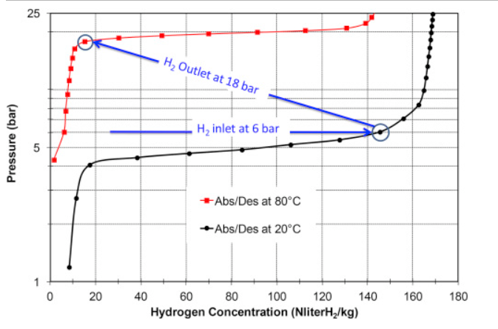

Energy demands for metal hydride compression
Principles of compression:
Adsorption
Desorption
Notes:
Forward reaction is adsorption and is exothermic and reverse is desorption and is endothermic. Therefore, during refuelling heat is generated and this causes the bed temperature to increase, which slows down the adsorption rate due to reaction kinetics. To maintain adsorption rates, cooling of the metal hydride bed is required.
During refuelling, a lot of hydrogen is absorbed in a short time leading to high rates of heat generation and this means that high cooling rates need to be used to maintain optimal temperatures. The opposite is true for desorption, as that progresses the bed cools down and the bed needs to be heated to maintain optimal desorption rates.
The position of equilibrium for the reaction is dependent on pressure, concentration, and temperature and is usually presented in a PCT-diagram.
Bit confused about the PCT graph. Im assuming the sharp increase is when hydrogen is absorbed quickly initially. I know the plateau is the reversible hydrogen capacity but what does it represent?

Slide 4


Compression stages
Multi-stage systems:
For compression, metal hydrides must be chosen so that:
  Operate within the range of operating temperatures and pressures
  High reversible hydrogen storage capacity at operating conditions
  Fast kinetics
  Tolerance to poisoning with impurities in the feed hydrogen
  Easy activation, Cyclic stability, Low cost, Ease of manufacturing
Notes:
For metal hydride compression systems, metal hydrides with specific thermodynamic properties are connected in series and a multi-stage system is created.
The idea behind this is that the desorption temperature of a material matches the absorption temperature of the next material, so the hydrogen progressively gets more and more compressed at each stage. Based on the thermodynamic properties of those materials, the hydrogen pressure at each stage increases, and at the final stage, the pressurised hydrogen is stored in a high pressure tank. Ask Charlie how this relates to the PCT graph.

Slide 5
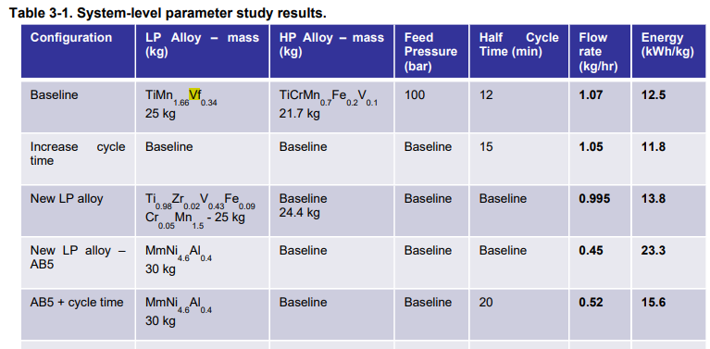
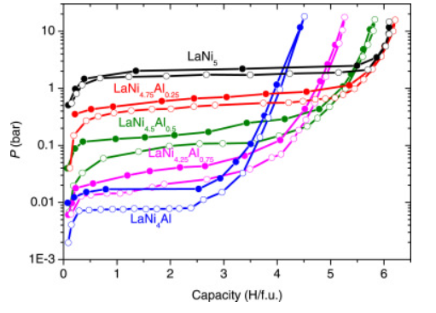
Emerald Green Power alloys
Notable findings from papers:
Purpose of elemental substitution in all these alloys is to alter hydrogen storage capacity, reaction kinetics?
TiMn1.66Vf0.34 in a previous study was used as the low-pressure candidate in a 2-stage system.
LaNi4.75Al0.25 – Al substitution has a strong effect on both plateau pressure and the capacity:
Notes:
Not very much literature available on these alloys, with the papers I could find, I attempted to create a very simple model (with lots of assumptions!) to calculate OPEX costs for one cycle of compression.
What is the purpose of elemental substituion? To my knowledge its to alter hydrogen storage capacity and plateau pressure but how does this affect its application in the real world?
In this study, they had a baseline configuration of TiMn1.66Vf0.34 as the LP candidate and another HP candidate alloy. Found that changing the low-pressure alloy from one AB2 to another created a slight performance hit in terms of flow rate (first and third rows) and changing to a lower pressure AB5 alloy caused a large performance hit (first row compared to 5th, 6th, 7th rows).
However, changing to smaller tube diameter to improve heat transfer and using asymmetric half cycles allowed the AB5 performance to approach that of the AB2 alloys (last row). Highlights that reduced tube diameter and feed pressure could potentially increase performance. Suggests that a 50 bar feed pressure is ideal.

Slide 6
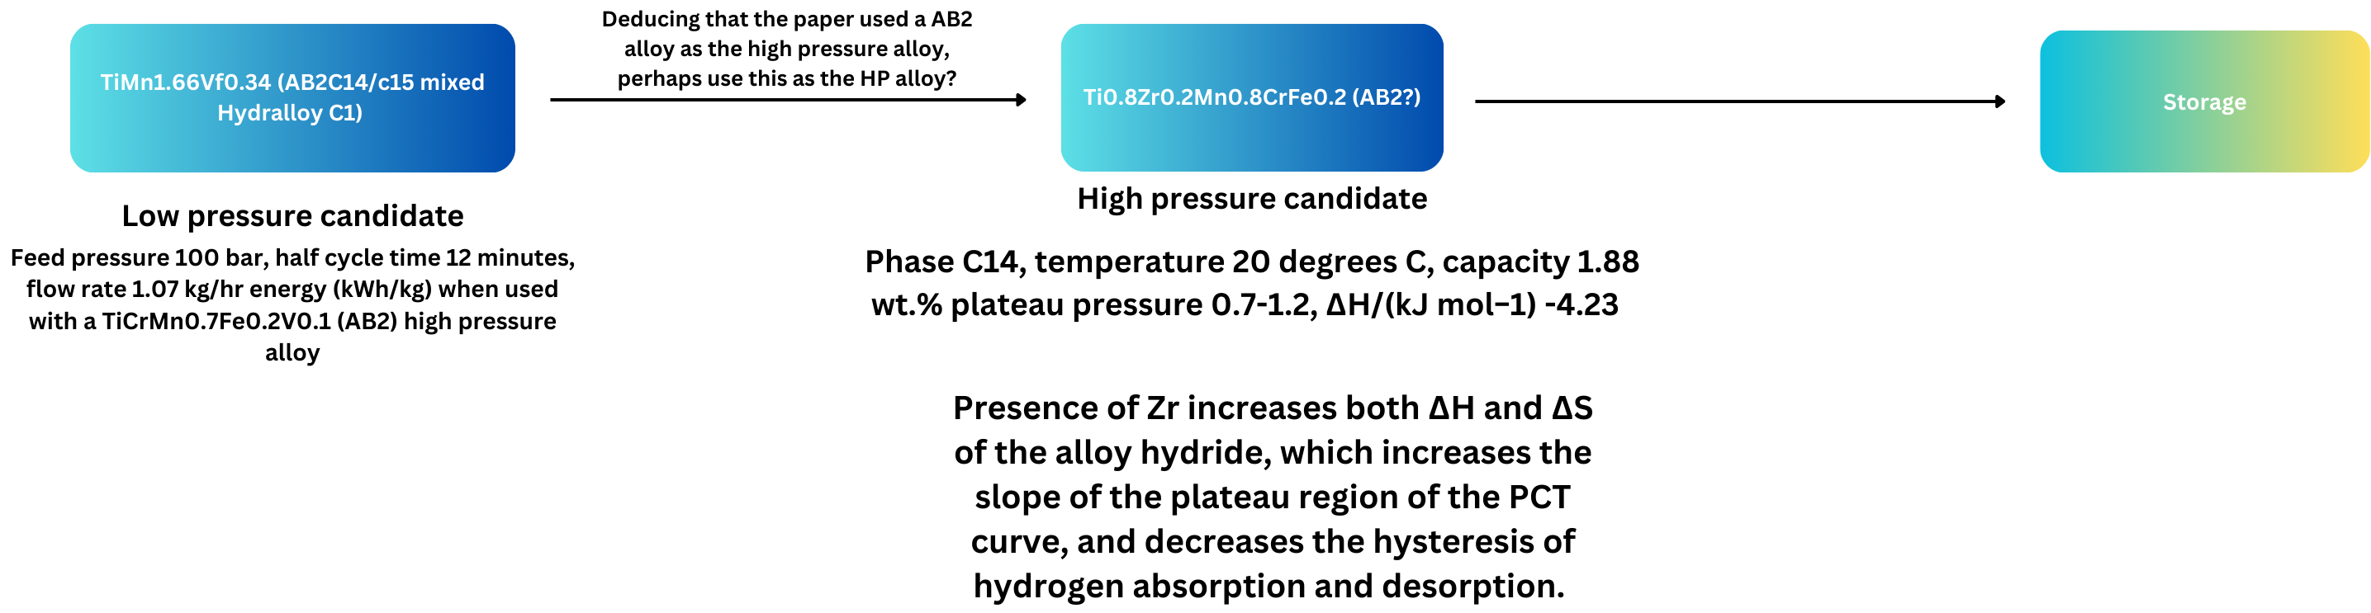
Attempt at modelling
Notes:
No. of stages: 2
Temperature for hydrogenation and dehydrogenation: 10 and 90C respectively as a rough estimate
Feed pressure: 20-50 bar final compression around 200 bar
Thermal energy requirement: (calculated from the average of case 2,3 , and 4) = 79.47 MJ
Compression duration (average from paper) 1924 seconds
This example uses a spiral heat exchanger (same as helical coil) and its material is stated as SS helical shell? Another paper uses Stainless steel so we will go with that
For stainless steel, this efficiency factor will depend on several factors, including coil design, temperature difference, and the ambient environment. For the sake of this calculation, let’s assume an efficiency from 0.5 to 0.9 for practical purposes, depending on specific conditions).
Considering a 75% efficiency, you would need approximately 106.03 MJ of electrical energy to produce 79.47 MJ of heat energy over 1924 seconds using a stainless steel helical coil. Adjusting the efficiency factor η\etaη will change this value accordingly.
Considering cost of electricity is 24.59p/kWh as of end of april 2024 (https://energyguide.org.uk/average-cost-electricity-kwh-uk/), cost of compression is £7.21 for one compression cycle.
I chose these two alloys because of the literature that exists, it said that TiMn1.66Vf0.34 was used as the LP candidate and since the paper used an AB2 alloy as the high pressure candidate, I used EGP’s AB2 alloy as the HP candidate. Papers that I read used stainless steel helical coils which have a variety of designs and characteristics but I didn’t include these other characteristics in my model because it would be too complicated.
What I did was a very crude elementary calculation where the SS coil has an efficiency that ranges from 50-90% so here I used 75%, then in the study previously mentioned you would need approximately 106.03 MJ of electrical energy to produce 79.47 MJ of heat energy over 1924 seconds using a stainless steel helical coil. Considering cost of electricity is 24.59p/kWh as of end of april 2024 (https://energyguide.org.uk/average-cost-electricity-kwh-uk/), cost of compression is £7.21 for one 1924 second compression cycle.

Slide 7
Reference list
Research and application of Ti–Mn-based hydrogen storage alloys | Journal of Iron and Steel Research International (springer.com)
https://www.osti.gov/servlets/purl/1898257
https://www.sciencedirect.com/science/article/pii/S1003632611607450
https://www.sciencedirect.com/science/article/pii/S2352152X23018534
https://www.sciencedirect.com/science/article/pii/S0360319919344301

